Slide 1
LESSON 5.1
Molecular Polarity

Slide 2
LESSON GOALS
I can predict molecular polarity from bond polarity and molecular geometry

Slide 3
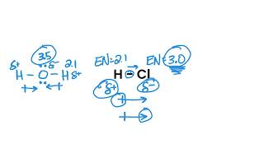
TASK 1: REVIEW (SHOULD DO)
Individually or with a partner:
Review the Bond Polarity video

Slide 4
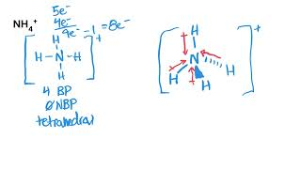
TASK 2: LEARN (MUST DO)
Individually or with a partner:
Watch the Molecular Polarity video
Complete the guided note

Slide 5
TASK 3: PRACTICE (MUST DO)
Individually or with a partner:
Complete the molecular polarity practice (check your answers when you are finished!)

Slide 6
TASK 4: MASTERY CHECK (MUST DO)
Individually:
Complete the molecular polarity mastery check (see me when you are ready!)

